Slide 1
ALM Objectives and Optimization
Dr.V.N.Sastry
Professor, IDRBT vnsastry@idrbt.ac.in
Asset Liability Management (ALM)
ALM Objectives of Banks
ALM Optimization Models

Slide 2
Asset Liability Management (ALM)
ALM is a strategic decision making approach to Integrated Risk Management.
It is useful for the existence, stability and growth of an entity or organization.
It helps to take appropriate actions in present to avoid crisis and to achieve business objectives.
In Banks it is done by ALCO ( Asset Liability Committee) on a periodic basis (fortnightly).
It requires consolidation of information, classification, identification and measurement of risks, specification of risk limits, market watch, prediction and formulation of strategic views on a dynamic basis.

Slide 3
CLASSES OF RISKS
( FINANCIAL , OPERATIONAL and OTHER)
MARKET RISK
  Interest Rate Risk
  Liquidity Risk
  Foreign Exchange Risk
CREDIT RISK
  Portfolio Risk
  Default Risk
OPERATIONAL RISK
OTHER RISKS
  Political Risk
  Country Risk
  Reputation Risk
  Systemic Risk
  Exposure Risk
  Liability Risk
  Asset/Liability Mismatch Risk

Slide 4
ASSET LIABILITY CATEGORY
FINANCIAL ASSETS AND LIABILITIES
  TREASURY MANAGEMENT OF DOMESTIC AND FOREX CURRENCY
    LIABILITY MANAGEMENT
      PRODUCT ANALYSIS
        LIQUIDITY RISK AND INTEREST RATE RISKS
      REVENUE GENERATION
        INTEREST BASED AND NON-INTEREST BASED INCOME
    ASSET MANAGEMENT
      INVESTMENT OR PORTFOLIO MANAGEMENT
        CREDIT RISK AND INTEREST RATE RISKS
NON-FINANCIAL ASSETS AND LIABILITIES.
  HRM, INFRASTRUCTURE, SECURITY ETC.
    OPERATIONAL RISK MANAGEMENT

Slide 5

ALM Cycle of Banks
Asset Cycle (Repayment to the Bank)
Bank
Asset
Returns
Investments,
Loans,
Advances
Borrowers
Lenders
Deposits,
Borrowings
Liability Repayments
Liability Cycle (Repayment by the Bank)
Interest based
Income
Expenditure
Interest based
Non-Interest based
Non-Interest based

Slide 6
Assets
6. Other Assets
5. Fixed Assets
4. Loans and advances
3. Investments
2. Balances with Banks and
Money at call and short notice
1.Cash and Balances at RBI
T1 T2 T3 T4 T5 T6 T7 T8 T9 T10
Time Buckets
1.Capital
2.Reserves and Surplus
T1 : 1 Day
T2 : 2D-7D
T3 : 8D-14D
T4 : 15D -1 Month
T5 : 1M-3M
T6 : 3M-6M
T7 : 6M-1Year
T8 : 1Y-3Y
T9 : 3Y-5Y
T10: >5Y
3.Deposits
4.Borrowings
5.Other Liabilities and Provisions
6.Contingent Liabilities
Liabilities

Slide 7
Some Objectives of ALM
Minimize Liquidity Risk ( Short Term)
Maximize Return on Equity
Maximize Market Value of Equity
Maximize Net Interest Income
Minimize Non Performance Assets
Maximize Regulatory Compliance
Maximize Competitive Advantage
Maximize Operational Efficiency
Maximize Customer Satisfaction Levels
Minimize Reputation Risk
Minimize Cost of Funds

Slide 8
Notations
r_{i} - interest of the Asset | TL_{i} - i-year total Liability
A_{i} - i-year market value of the Asset | ∆_{i} - i-year market value of the difference on Liability and Asset
TA_{i} - i-year total Asset | a_{si} – Coefficient of the i^{th} asset in the s^{th} constraint condition.
b_{s} – constant of the s-constraint condition | u – number of constraint conditions

Slide 9
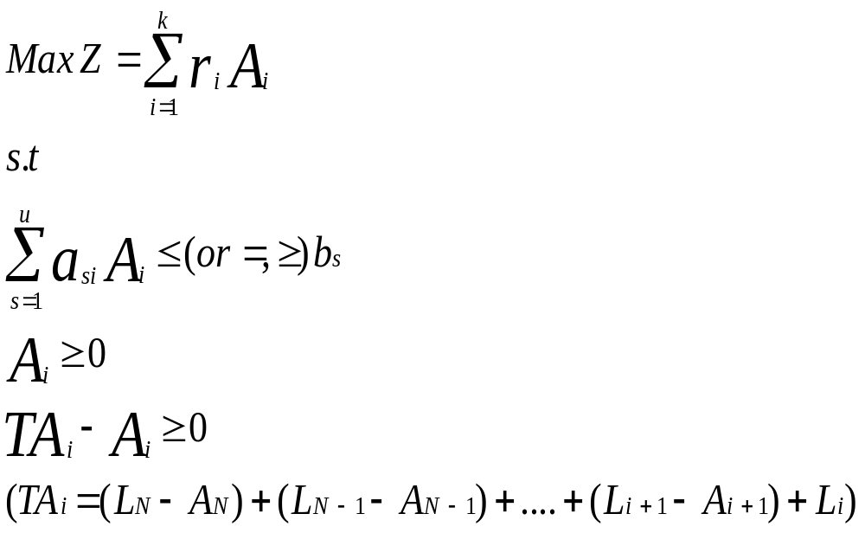
ALM with Maximization of NII

Slide 10
Example
Liability name | Book value(Lj) (million) | Asset Ai | Monthly interest (%)ri
Current deposit | 20000 | Cash | 0.000
Three months deposit | 15000 | Reserve against deposit | 1.725
Six months deposit | 5000 | Provision | 1.725
One year deposit | 15000 | Deposit head office | 4.500
Three year deposit | 25000 | Three months loan | 4.650
Five year deposit | 20000 | Six months loan | 4.650
Total liabilities | 100000 | One year loan | 4.875
 |  | Three year loan | 4.950
 |  | Five year loan | 5.025

Slide 11

s.t.
The constraint condition of asset scale
The constraint condition on proportion of cash holdings based on liquidity
The constraint condition on proportion of cash holdings based on liquidity profitability

Slide 12



The proportion of legal reserve requirement
The proportion of provision for payment
The proportion of asset liquidity
The proportion of deposit and loan

Slide 13

The proportion of medium and long term loan
The structure of medium and long term loan
Nonnegative time structure constraint of 5-year assets-liabilities (L6-A9≥0)
Nonnegative time structure constraint of 3-year assets-liabilities
((L6-A9)+L5-A8≥0)

Slide 14
Nonnegative time structure constraint of 1-year assets-liabilities
((L6-A9)+(L5-A8)+L4-A7≥0)
Nonnegative time structure constraint of 6-month assets-liabilities
((L6-A9)+(L5-A8)+(L4–A7)+L3-A6≥0)
Nonnegative time structure constraint of 1-month assets-liabilities
((L6-A9)+(L5-A8)+(L4-A7)+(L3-A6)+L2-A5≥0)

Slide 15
Results
Variables(million) | output
A₁ | 600
A₂ | 6000
A₃ | 4400
A₄ | 14000
A₅ | 11532
A₆ | 3468
A₇ | 15000
A₈ | 20000
A₉ | 10000
Interest income Z | 448.065

Slide 16


ALM with Maximization of Terminal Cash-flows
Notations
Liabilities | Assets
n: Number of Liabilities (L₁…..L_{n}) | m: Number of Assets (A₁…..A_{m})
L_{i}: i’th Liability; i=1 to n | A_{j}: j’th Asset; j=1 to m
X_{i}^{kl}: Amount borrowed from the Liability L_{i} during k’th time bucket and which is going to be matured in l’th time bucket. | Y_{j}^{kl}: Amount invested to the Asset Aj during k’th time bucket and which is going to be matured in l’th time bucket.
IL_{i}^{kl}: Interest rate on liability Li | IA_{j}^{kl}: Interest rate on Asset Aj

Slide 17
Notations
Liabilities | Assets
TL_{i}^{kl}: Time period for which the amount is borrowed from the Liability L_{i} | TA_{j}^{kl}: Time period for which the amount is invested in the Asset A_{j}
t: number of time buckets
G_{k}: Gap value in the k’th time bucket; k=1 to t
DG_{l}: Dynamic Gap maturing in the l’th bucket corresponding to the borrowings and investments made prior to l’th periods.
k, l and o are variables
V is the wealth of the bank

Slide 18

ASSUMPTIONS
The Gap values of all the time buckets are assumed to be given.
The principal and the interest amount for Liabilities as well as Assets is to be paid or received respectively after the maturity period.
Assuming that there are no Assets or Liabilities in the previous buckets from which amount is expected to return or the amount to be paid respectively in the first time bucket. i.e..when k=1.
Assuming that there is no need to concentrate on borrowing and investing in the last bucket.
Here considering the wealth at the end of time horizon.

Slide 19
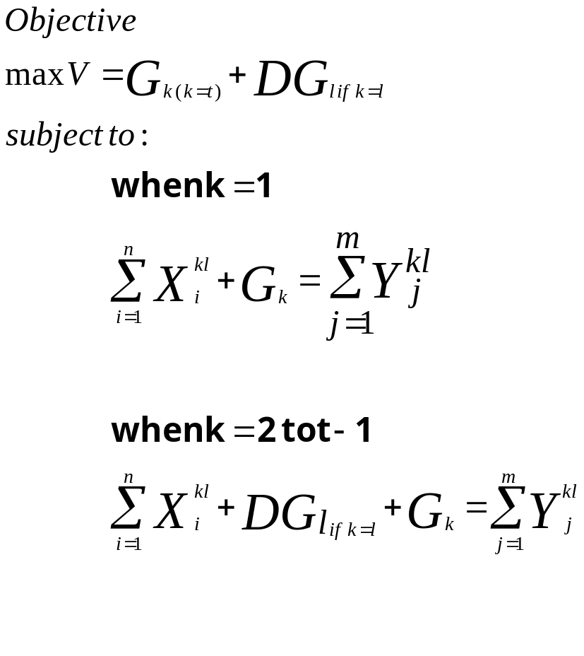
Cash-Flow Optimization Model for Asset Liability Management
Here objective is to Maximize the wealth of the bank (V).

Slide 20
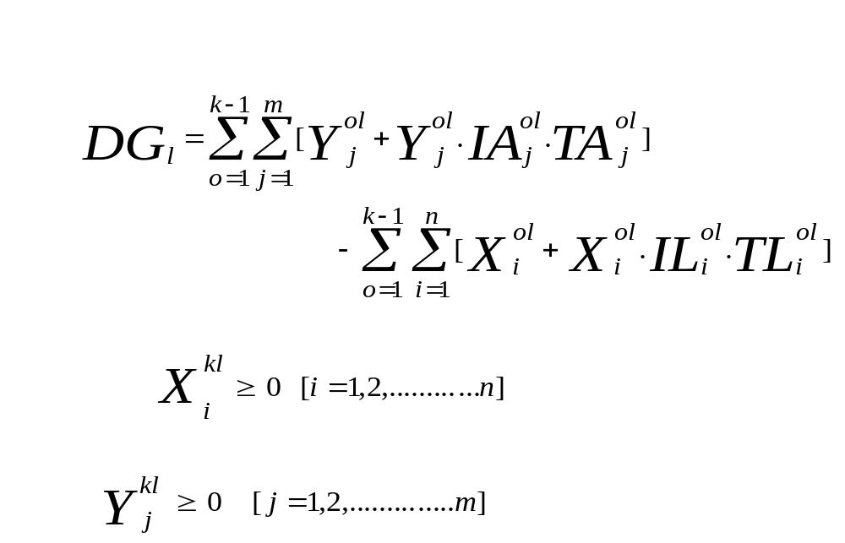

Slide 21
Example
Assets | Interest Rate per month(%) | Liabilities | Interest Rate per month(%)
5 days | 5.85 | 10 days | 1.26
Treasury Bill(14 days) | 5.55 | Fixed deposit for 20 days | 1.45
Loan(1 month) | 4.650 | Fixed deposit for 1 month | 1.5
Loan(6 months) | 4.650 | Fixed deposit for 3 months | 1.605
Deposit to the head office(6 months) | 4.500 | Fixed deposit for 6 months | 1.800

Slide 22
RSA | RSL | Gap=RSA-RSL
2437.02 | 2205.51 | 231.51
3920.75 | 3827.11 | 93.64
3547.04 | 2325.08 | 1221.96
4662.59 | 1414.86 | 3247.73
14576.06 | 7400.28 | 7175.78
12170.8 | 16090.48 | -3919.68

Slide 23
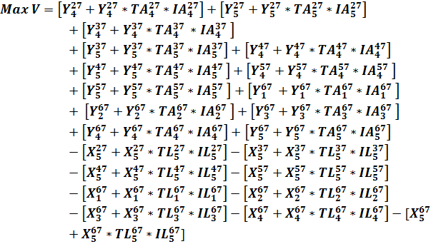

Slide 24

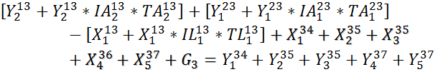
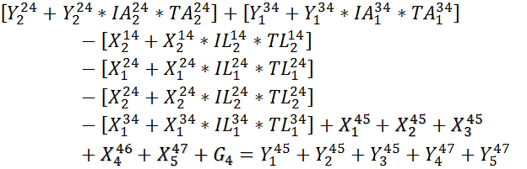

Slide 25
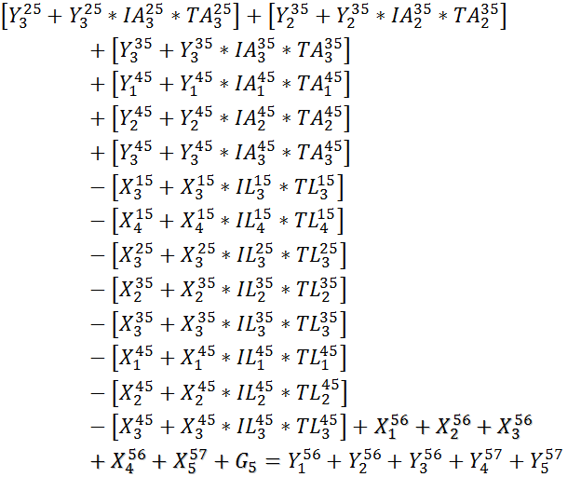

Slide 26

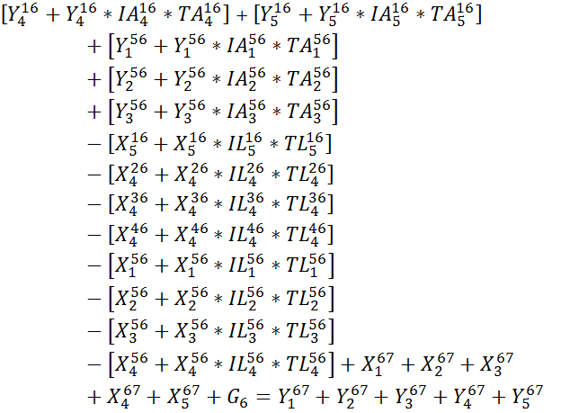

Slide 27
Coefficient Matrix
1 | 1 | 1 | 1 | 1 | 1 | 1 | 1 | 1 | 1 | 2 | 2 | 2 | 2 | 2 | 2 | 2 | 2 | 2 | 2
X₁ | X₂ | X₃ | X₄ | X₅ | Y₁ | Y₂ | Y₃ | Y₄ | Y₅ | X₁ | X₂ | X₃ | X₄ | X₅ | Y₁ | Y₂ | Y₃ | Y₄ | Y₅
1 | 1 | 1 | 1 | 1 | -1 | -1 | -1 | -1 | -1 | 0 | 0 | 0 | 0 | 0 | 0 | 0 | 0 | 0 | 0
0 | 0 | 0 | 0 | 0 | 1.00975 | 0 | 0 | 0 | 0 | 1 | 1 | 1 | 1 | 1 | -1 | -1 | -1 | -1 | -1
-1.0042 | 0 | 0 | 0 | 0 | 0 | 1.02775 | 0 | 0 | 0 | 0 | 0 | 0 | 0 | 0 | 1.00975 | 0 | 0 | 0 | 0
0 | -1.00966 | 0 | 0 | 0 | 0 | 0 | 0 | 0 | 0 | -1.0042 | -1.00966 | 0 | 0 | 0 | 0 | 1.02775 | 0 | 0 | 0
0 | 0 | -1.015 | -1.04815 | 0 | 0 | 0 | 1.0465 | 0 | 0 | 0 | 0 | -1.015 | 0 | 0 | 0 | 0 | 1.0465 | 0 | 0
0 | 0 | 0 | 0 | -1.108 | 0 | 0 | 0 | 1.279 | 1.27 | 0 | 0 | 0 | -1.04815 | 0 | 0 | 0 | 0 | 0 | 0

Slide 28
Coefficient Matrix
3 | 3 | 3 | 3 | 3 | 3 | 3 | 3 | 3 | 3 | 4 | 4 | 4 | 4 | 4 | 4 | 4 | 4 | 4 | 4
X₁ | X₂ | X₃ | X₄ | X₅ | Y₁ | Y₂ | Y₃ | Y₄ | Y₅ | X₁ | X₂ | X₃ | X₄ | X₅ | Y₁ | Y₂ | Y₃ | Y₄ | Y₅
0 | 0 | 0 | 0 | 0 | 0 | 0 | 0 | 0 | 0 | 0 | 0 | 0 | 0 | 0 | 0 | 0 | 0 | 0 | 0
0 | 0 | 0 | 0 | 0 | 0 | 0 | 0 | 0 | 0 | 0 | 0 | 0 | 0 | 0 | 0 | 0 | 0 | 0 | 0
1 | 1 | 1 | 1 | 1 | -1 | -1 | -1 | -1 | -1 | 0 | 0 | 0 | 0 | 0 | 0 | 0 | 0 | 0 | 0
-1.0042 | 0 | 0 | 0 | 0 | 1.00975 | 0 | 0 | 0 | 0 | 1 | 1 | 1 | 1 | 1 | -1 | -1 | -1 | -1 | -1
0 | -1.00966 | -1.015 | 0 | 0 | 0 | 1.02775 | 1.0465 | 0 | 0 | -1.0042 | -1.00966 | -1.015 | 0 | 0 | 1.00975 | 1.02775 | 1.0465 | 0 | 0
0 | 0 | 0 | -1.04815 | 0 | 0 | 0 | 0 | 0 | 0 | 0 | 0 | 0 | -1.04815 | 0 | 0 | 0 | 0 | 0 | 0

Slide 29
Coefficient Matrix
5 | 5 | 5 | 5 | 5 | 5 | 5 | 5 | 5 | 5 | 6 | 6 | 6 | 6 | 6 | 6 | 6 | 6 | 6 | 6
X₁ | X₂ | X₃ | X₄ | X₅ | Y₁ | Y₂ | Y₃ | Y₄ | Y₅ | X₁ | X₂ | X₃ | X₄ | X₅ | Y₁ | Y₂ | Y₃ | Y₄ | Y₅
0 | 0 | 0 | 0 | 0 | 0 | 0 | 0 | 0 | 0 | 0 | 0 | 0 | 0 | 0 | 0 | 0 | 0 | 0 | 0
0 | 0 | 0 | 0 | 0 | 0 | 0 | 0 | 0 | 0 | 0 | 0 | 0 | 0 | 0 | 0 | 0 | 0 | 0 | 0
0 | 0 | 0 | 0 | 0 | 0 | 0 | 0 | 0 | 0 | 0 | 0 | 0 | 0 | 0 | 0 | 0 | 0 | 0 | 0
0 | 0 | 0 | 0 | 0 | 0 | 0 | 0 | 0 | 0 | 0 | 0 | 0 | 0 | 0 | 0 | 0 | 0 | 0 | 0
1 | 1 | 1 | 1 | 1 | -1 | -1 | -1 | -1 | -1 | 0 | 0 | 0 | 0 | 0 | 0 | 0 | 0 | 0 | 0
-1.0042 | -1.00966 | -1.015 | -1.04815 | 0 | 1.00975 | 1.02775 | 1.0465 | 0 | 0 | 1 | 1 | 1 | 1 | 1 | -1 | -1 | -1 | -1 | -1

Slide 30
Results
1. X₁ | 44.91 | 2. Y₁ | 58.21
1. X₂ | 44.67 | 2. Y₂ | 59.18
1. X₃ | 44.51 | 2. Y₃ | 60.75
1. X₄ | 43.37 | 2. Y₄ | 33.23
1. X₅ | 41.21 | 2. Y₅ | 339.55
1. Y₁ | 74.01 | 3. X₁ | 55.16
1. Y₂ | 117.00 | 3. X₂ | 54.81
1. Y₃ | 127.39 | 3. X₃ | 54.52
1. Y₄ | 27.10 | 3. X₄ | 55.02
1. Y₅ | 104.67 | 3. X₅ | 25.46
2. X₁ | 55.78 | 3. Y₁ | 55.85
2. X₂ | 55.48 | 3. Y₂ | 56.94
2. X₃ | 55.32 | 3. Y₃ | 58.08
2. X₄ | 52.86 | 3. Y₄ | 454.63
2. X₅ | 25.41 | 3. Y₅ | 392.73

Slide 31
Results
4. X₁ | 55.08 | 5. Y₁ | 56.92
4. X₂ | 54.77 | 5. Y₂ | 58.03
4. X₃ | 54.48 | 5. Y₃ | 59.23
4. X₄ | 54.81 | 5. Y₄ | 526.62
4. X₅ | 25.45 | 5. Y₅ | 396.93
4. Y₁ | 55.95 | 6. X₁ | 28.05
4. Y₂ | 57.01 | 6. X₂ | 27.89
4. Y₃ | 58.15 | 6. X₃ | 27.75
4. Y₄ | 515.30 | 6. X₄ | 26.87
4. Y₅ | 602.44 | 6. X₅ | 25.42
5. X₁ | 57.57 | 6. Y₁ | 149.16
5. X₂ | 57.24 | 6. Y₂ | 162.99
5. X₃ | 56.91 | 6. Y₃ | 180.57
5. X₄ | 54.99 | 6. Y₄ | 202.62
5. X₅ | 25.46 | 6. Y₅ | 2.08
 |  | Wealth V | 4677.18

Slide 32
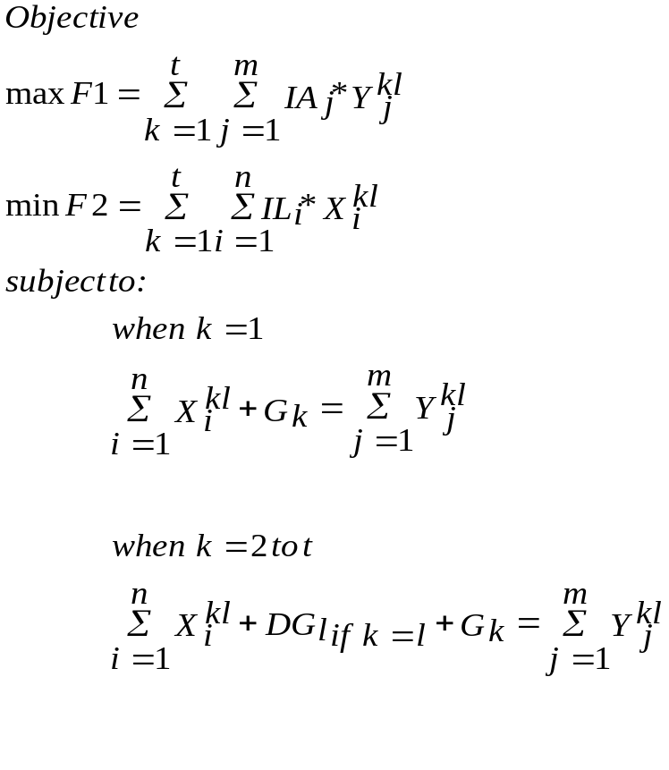
Multi Objective Cash-Flow Optimization for Asset Liability Management

Slide 33
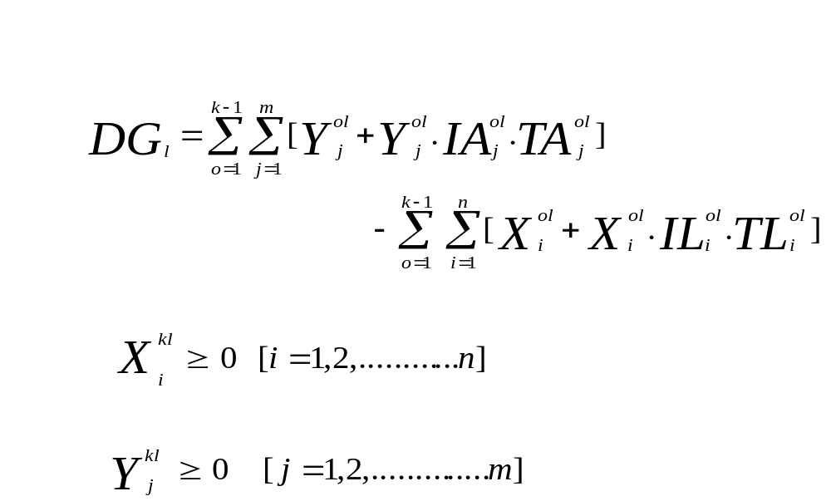

Slide 34
Example
Assets | Interest Rate per month(%) | Liabilities | Interest Rate per month(%)
5 days | 5.85 | 10 days | 1.26
TreasuryBill(14 days) | 5.55 | Fixed deposit for 20 days | 1.45
Loan(1 month) | 4.650 | Fixed deposit for 1 month | 1.5

Slide 35
RSA | RSL | Gap=RSA-RSL
2437.02 | 1007.64 | 1429.38
3920.75 | 3827.11 | 93.64
3547.04 | 2325.08 | 1221.96
4662.59 | 1414.86 | 3247.73
14576.06 | 7400.28 | 7175.78

Slide 36
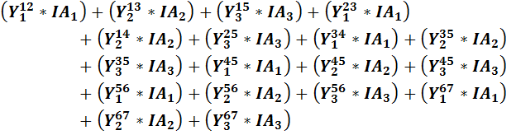
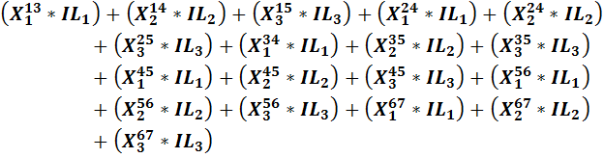
Max F1
Min F2

Slide 37

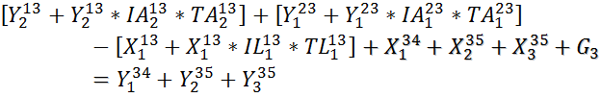
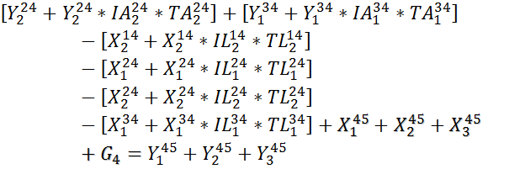
s.t.

Slide 38
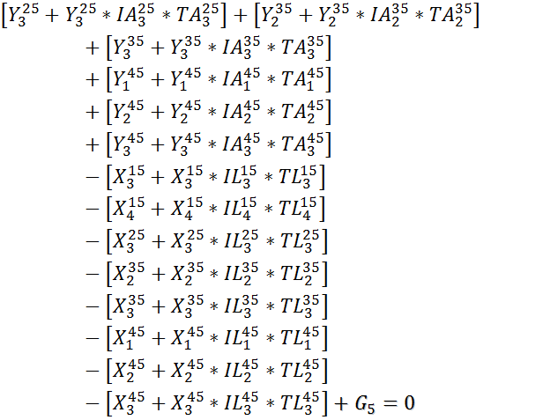

Slide 39
Results
1. X₁ | 47.8914 | 3. X₁ | 16.71021
1. X₂ | 73.21039 | 3. X₂ | 0.191611
1. X₃ | 0.375971 | 3. X₃ | 0.161202
1. Y₁ | 1302.645 | 3. Y₁ | 2669.108
1. Y₂ | 0 | 3. Y₂ | 42.2259
1. Y₃ | 248.2129 | 3. Y₃ | 0.1228
2. X₁ | 46.54217 | 4. X₁ | 0.104928
2. X₂ | 50.39455 | 4. X₂ | 0.089729
2. X₃ | 0.26807 | 4. X₃ | 253.1517
2. Y₁ | 1505.723 | 4. Y₁ | 253.7201
2. Y₂ | 1017.866 | 4. Y₂ | 63.75341
2. Y₃ | 0.467869 | 4. Y₃ | 6.839314
 |  | F1 | 1487.6444
 |  | F2 | 3795.266

Slide 40
Conclusions
The Proposed model covers two main objectives of Asset Liability Management, Liquidity and Profitability. Liquidity Risk is managed by considering Flow approach and profitability is ensured by taking the objective as maximize the wealth of the bank.
The Proposed Model is different from the Existing Models as it is able to consider both the Assets as well as Liabilities side for Asset Liability Management.

Slide 41
References
Zhongyuan Yang & Wen Xu. (2009). Optimization Model of Asset-Liability Portfolio Based on Controlling Liquidity Risk. IEEE, 978-1-4244-4639.
W. T. 2001. (2001). Worldwide Asset Liability Modeling, Cambridge University press.
Sam Srinivasulu. (2003). Asset Liability Management, euromoney-dc gardner workbooks, second edition.
GuvenE. Persentili, Omega. (1997). A linear programming model for bank balance sheet management, Volume 25, Issue 4, Pages 449-459.
Eatman and Sealay. (1979). A multiobjective linear programming model for commercial bank balance sheet management, Journal of Bank Research. 9, 227-236.

Slide 42
M. I. Kusy and W. T. Ziemba. (1986). A Bank Asset and Liability Management Model, , Operations Research, 34(3), pp. 356-376.
Cohen & Hammer. (1961). Linear Programming and Optimal Bank Asset Liability Management Decisions, , Journal of finance, 22, 42-61.
Fielitz & Loeffler. (1979). A Linear Programming Model for Commercial Bank Liquidity Management, Financial Management, 8/3, 44-50.
Charnes & Thore. (1966). Planning for Liquidity in Financial Institution: The Chance Constrained Method, , Journal of finance, 21/4, 649-674.
Pogue & Bussard. (1972). A Linear Programming Model for Short Term Financial Planning under uncertainity, , Sloan Management Review 13, 69-98.

Slide 43
Joel Bessis, John Wiley & Sons. (1999). Risk management in Banking, England.
http://www.rbi.gov.in
J Fabozzi and Atsuo Konishi, Irwin. (1996). The Hand book of Asset Liability Management- Frank, McGraw-Hill.
T Ravi Kumar. (2000). Asset Liability Management, Vision Books Pvt. Ltd., New Delhi.
PHI, Hamdy A. Taha. (2001). Operational Research, An Introduction.
Narendar Dheeravath & V. N. Sastry. (2007). Multi-objective Stochastic Programming /model for Asset Liability Management of Banks.
Narendar Dheeravath & V. N. Sastry. (2007). Comparative Analysis of Asset Liability Positions of Indian Public Sector Banks.

Slide 44
Guotai CHI & Feng CHI. (2007). Optimization Model of Asset-Liability Portfolio Considering Duration Perfect Matching, IEEE International Conference on Control and Automation Guangzhou, CHINA.
Dawen Yan, Guotai Chi & Haowen Wu. (2009). Assets and Liabilities Management Optimal Model Based on VaR Controlled Prepared Duration Gap, , IEEE International Joint Conference on Computational Sciences and Optimization 978-0-7695-3605.
Duojiao Tan. (2010). A Normative Analysis on Liquidity Risk Management, , IEEE 978-1-4244-6932.
Asset Liability Management. Retrieved on March 5, 2004 from http://www.riskglossary.com/articles/asset_liability_management.htm
Karthik Srinivasan & Vineet Gupta. Liquidity Management in Banks-An Increasingly complex affair.

Slide 45
W.T.Ziemba & J.M.Mulvey. (2001). Worldwide Asset Liability Modeling, Cambridge University press.
Ajay kumar & D. P. Chatterjee. (2005). Risk Management, Indian Institute of Banking and Finance, Macmillan India Limited.
Indian Institute of Banking and Finance http://www.iibf.org.in/
http://www.allbankingsolutions.com/

Slide 46
Thank You

